Slide 1

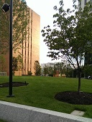
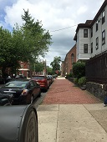
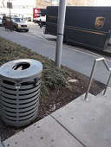

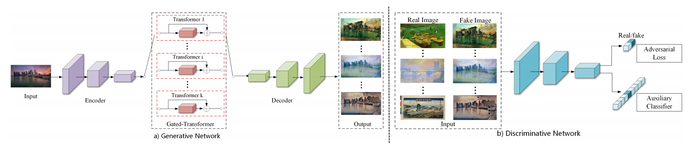
Motivation and Method
Latent style classification problem such as source camera identification (SCI) is hard even for human. But previous CNN based classification works well.
The problem we want to solve: what are the style features that is considered by the CNN model?
The difficulty we have: the content always mix with style and it is hard to separate the style and study it independently.
The method we propose: Use a GAN to perform camera style-transfer to separate the style from the content.
HTC M7
iPhone 6
LG Nexus 5X
Galaxy Note 3

Slide 2
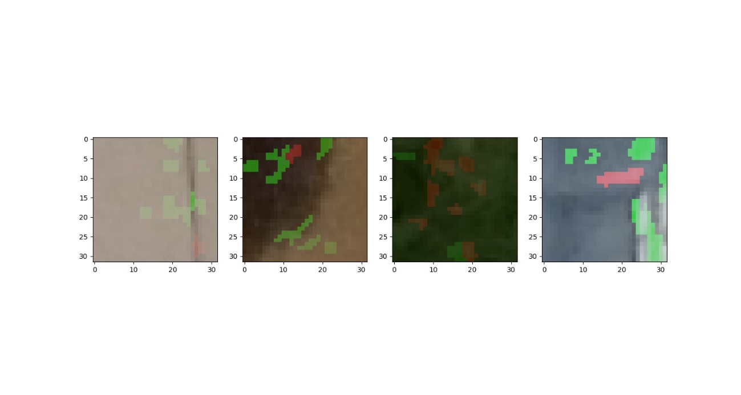
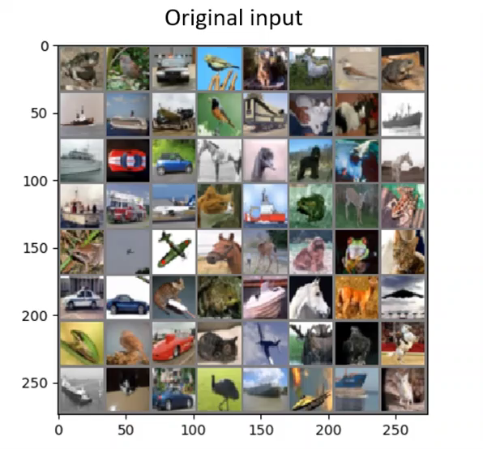
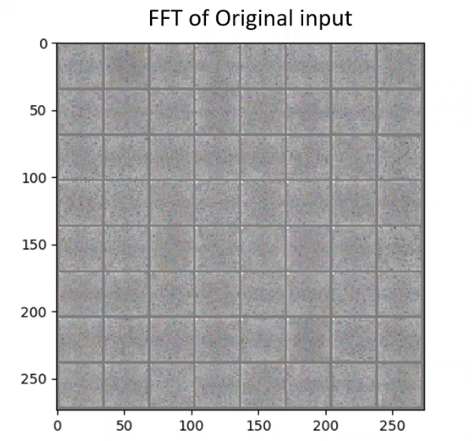
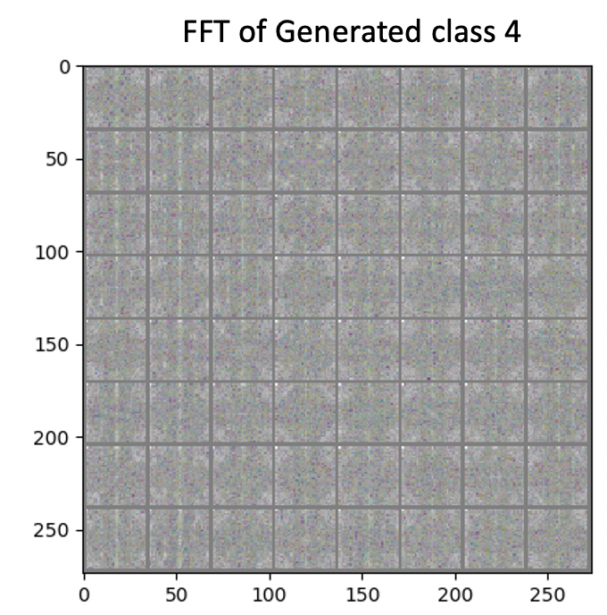
Style Visualization
Generator is able to transfer the input (with no style) to any style and cheat the classifier.
The FFT indicates that one style shows one specific frequency domain pattern which is content-free.
Lime [1], which can not catch the style correctly
[1] “Why Should I Trust You?” Explaining the Prediction of Any Classifier, M. T. Ribeiro, S. Singh and C. Guestrin

